Slide 1
Wine Quality Prediction
AI/ML Internship Project
Notes:
1.7.2013
1
‹#›

Slide 2


Project Team
Presented by
Nandana R Nath
Sona Soman
Teresa Sam Panicker
Vaishnavi Jayakumar
Under the Guidance of
Elizabeth Sony Thomas Jeena George
Asst.Prof - CS,AI Asst.Prof - AI
Providence College of Engineering Providence College of Engineering
Notes:
1.7.2013
2
‹#›

Slide 3
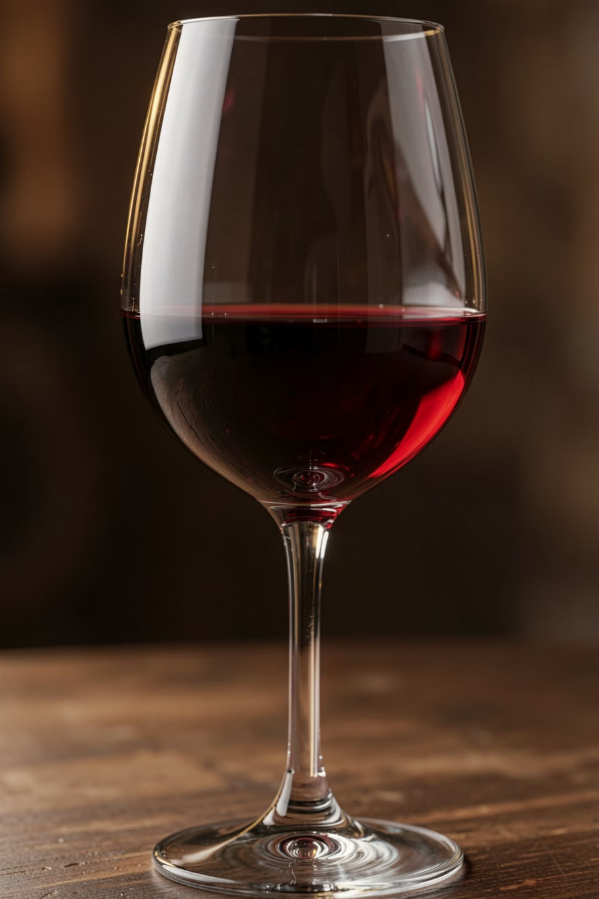
Problem Statement
Wine quality assessment is traditionally performed through sensory evaluation by expert tasters, which can be subjective, time-consuming, and costly. This project aims to develop a machine learning model that predicts the quality of wine based on its physicochemical properties.
Task
Input
Output
Multiclass Classification
11 chemical properties of wine
Predicted wine quality score (0-10)
Notes:
1.7.2013
3
‹#›

Slide 4
Why Is This Useful in Real Life
1
2
3
Reduces Dependence on Manual Wine Tasting
Enables Faster and More Consistent Quality Assessment
Helps Manufacturers Maintain Product Standards
4
5
Saves Time and Operational Costs in Quality Control
Data-Driven Decision-Making in Food & Beverage
Notes:
1.7.2013
4
‹#›

Slide 5
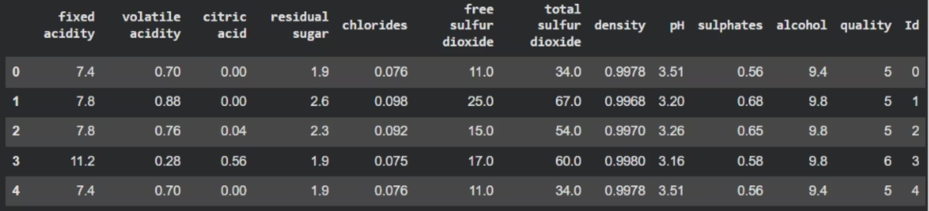




Dataset Overview
Dataset
Source
Features
Wine Quality Dataset
Kaggle
11 chemical properties of wine
Target Variable
Target Classes
Quality Score
Quality ratings ranging from 0 to 10
Notes:
1.7.2013
5
‹#›

Slide 6


Features Used
The model uses 11 physicochemical properties of wine as input features to predict quality:
Fixed Acidity
Volatile Acidity
Citric Acid
Residual Sugar
Chlorides
Free Sulfur Dioxide
Total Sulfur Dioxide
Density
pH
Sulphates
Alcohol
Notes:
1.7.2013
6
‹#›

Slide 7
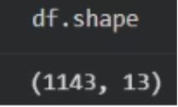
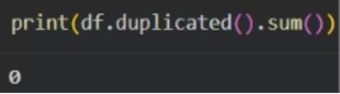
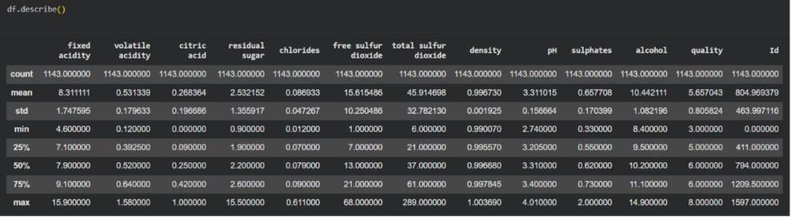
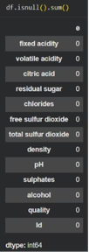
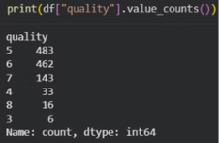
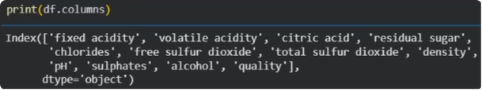
Data Preprocessing
Analyzed dataset structure and dimensions - df.shape()
Checked for duplicate records - df.duplicated().sum()
Performed missing value analysis - df.isnull().sum()
Reviewed statistical summaries - df.describe()
No missing values were found in the dataset.
Examined the distribution of the target variable - df["quality"].value_counts()
Verified feature names - df.columns()
Notes:
1.7.2013
7
‹#›

Slide 8
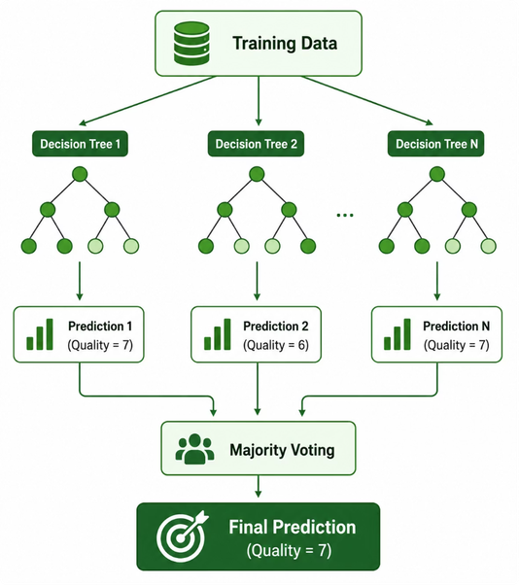
Machine Learning Model
Random Forest Classifier is an ensemble learning algorithm that combines the predictions of multiple decision trees to make robust and consistent classifications. Each tree independently predicts the output class, and the final prediction is determined through majority voting.
Why Random Forest?
Handles complex and non-linear relationships effectively
Reduces overfitting by combining multiple decision trees
Provides strong predictive performance for classification tasks
Works well with tabular datasets containing multiple features
Identifies the importance of each feature in the prediction process
Working Principle
Multiple decision trees are built using random subsets of the training data.
Each tree predicts the wine quality independently.
The final wine quality score is determined by the majority vote of all trees
Notes:
1.7.2013
8
‹#›

Slide 9
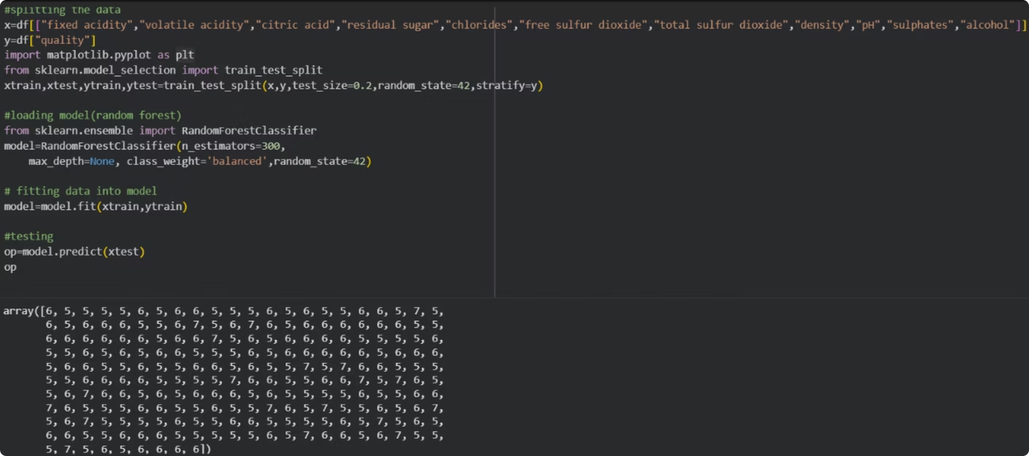
Model - Training and Testing
The wine quality dataset was divided into training and testing datasets. The Random Forest model was trained using the training data and then evaluated using the testing data. The model predicted the quality of wines in the test dataset, and these predictions were compared with the actual values to assess its performance. The results demonstrated that the model was able to identify meaningful patterns in the data and achieve satisfactory predictive performance.
Notes:
1.7.2013
9
‹#›

Slide 10


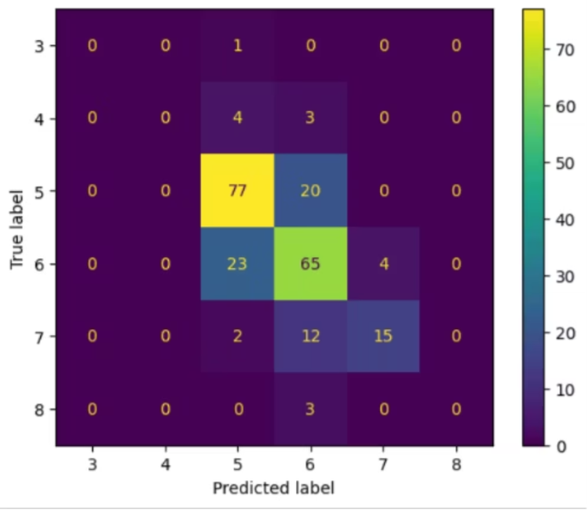
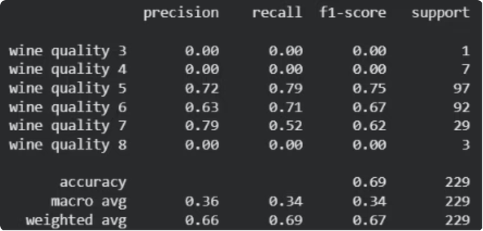
Results
Accuracy
F1 Score
68.5589519650655
0.666742
Confusion Matrix
Classification Report
Notes:
1.7.2013
10
‹#›

Slide 11


Conclusion
This project demonstrated the successful application of the Random Forest Classifier to predict wine quality using its physicochemical properties. By analyzing 11 chemical characteristics of wine, the model was able to learn meaningful patterns and classify wine quality effectively.
The trained model achieved promising results on unseen test data, demonstrating the feasibility of using machine learning for wine quality prediction. The results highlight the potential of machine learning techniques in automating quality assessment processes that traditionally rely on human expertise.
Overall, this project showcases how data-driven approaches can support faster, more consistent, and cost-effective decision-making in the food and beverage industry.
Final Thought💡
The successful implementation of this project highlights the potential of machine learning to provide efficient, objective and data-driven solutions for real-world quality prediction tasks
Notes:
1.7.2013
11
‹#›

Slide 12
Thank You
We extend our sincere gratitude to our mentors, coordinators, and everyone who supported us throughout this project. We hope this presentation has offered valuable insights into the practical applications of machine learning in wine quality prediction.
Thank you for your valuable time and attention
Notes:
1.7.2013
12
‹#›

